Slide 1

TEAM-5: Anupriya R, Reethika Selvam S, Gadhamsetty Pola Sreeja,Boyapatti Nissita Sree

Slide 2


Slide 3
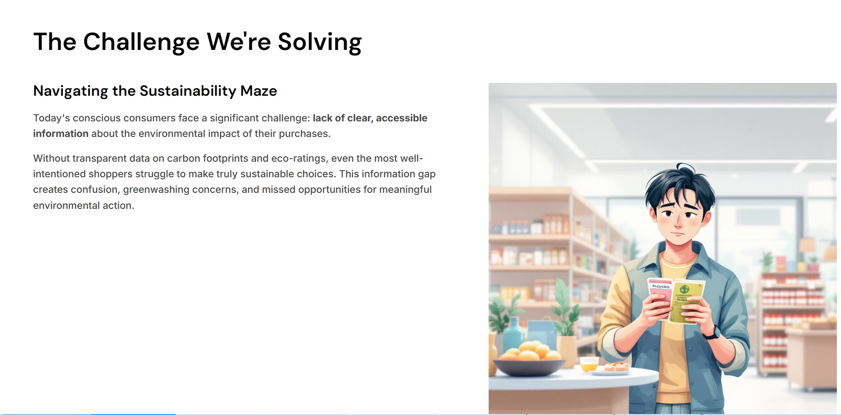

Slide 4
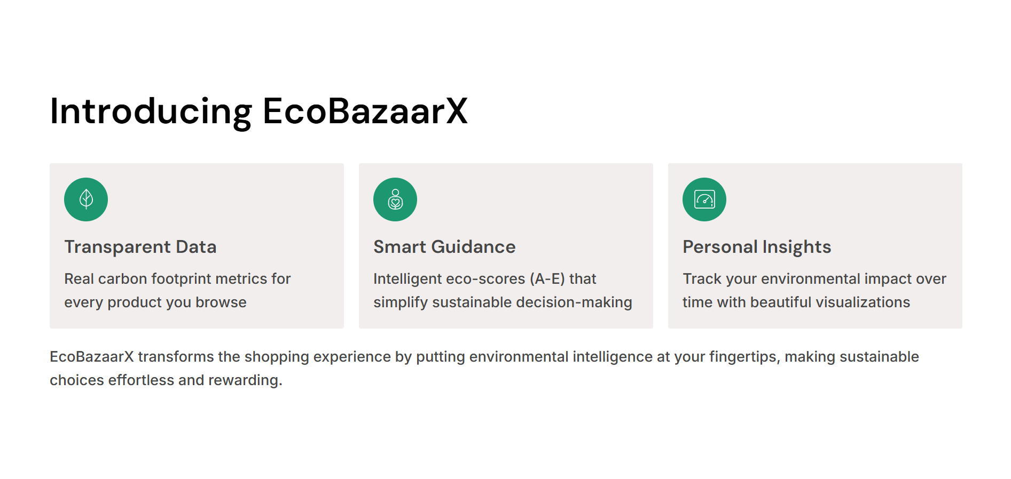

Slide 5
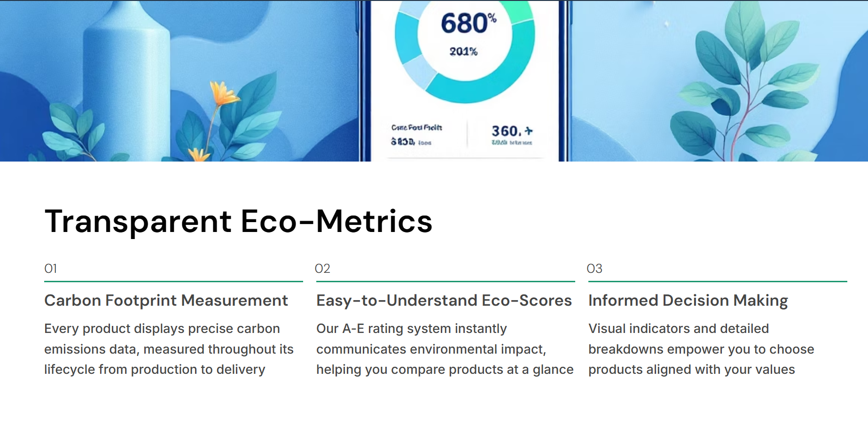

Slide 6
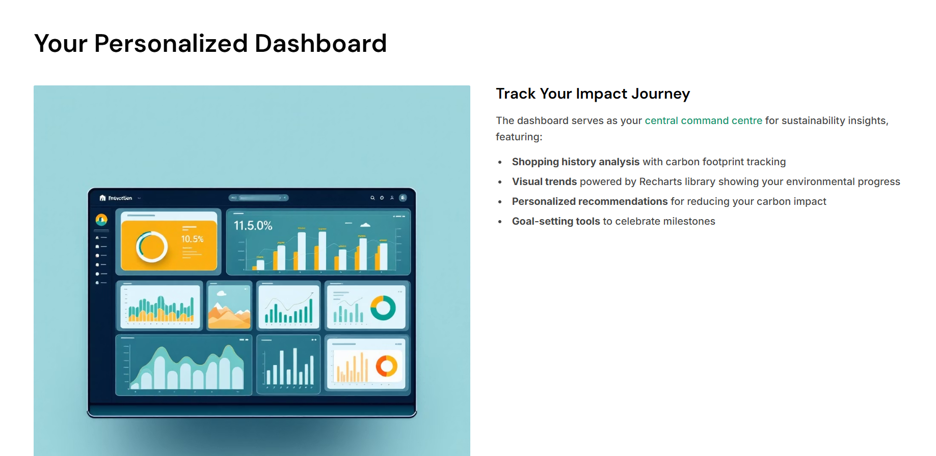

Slide 7
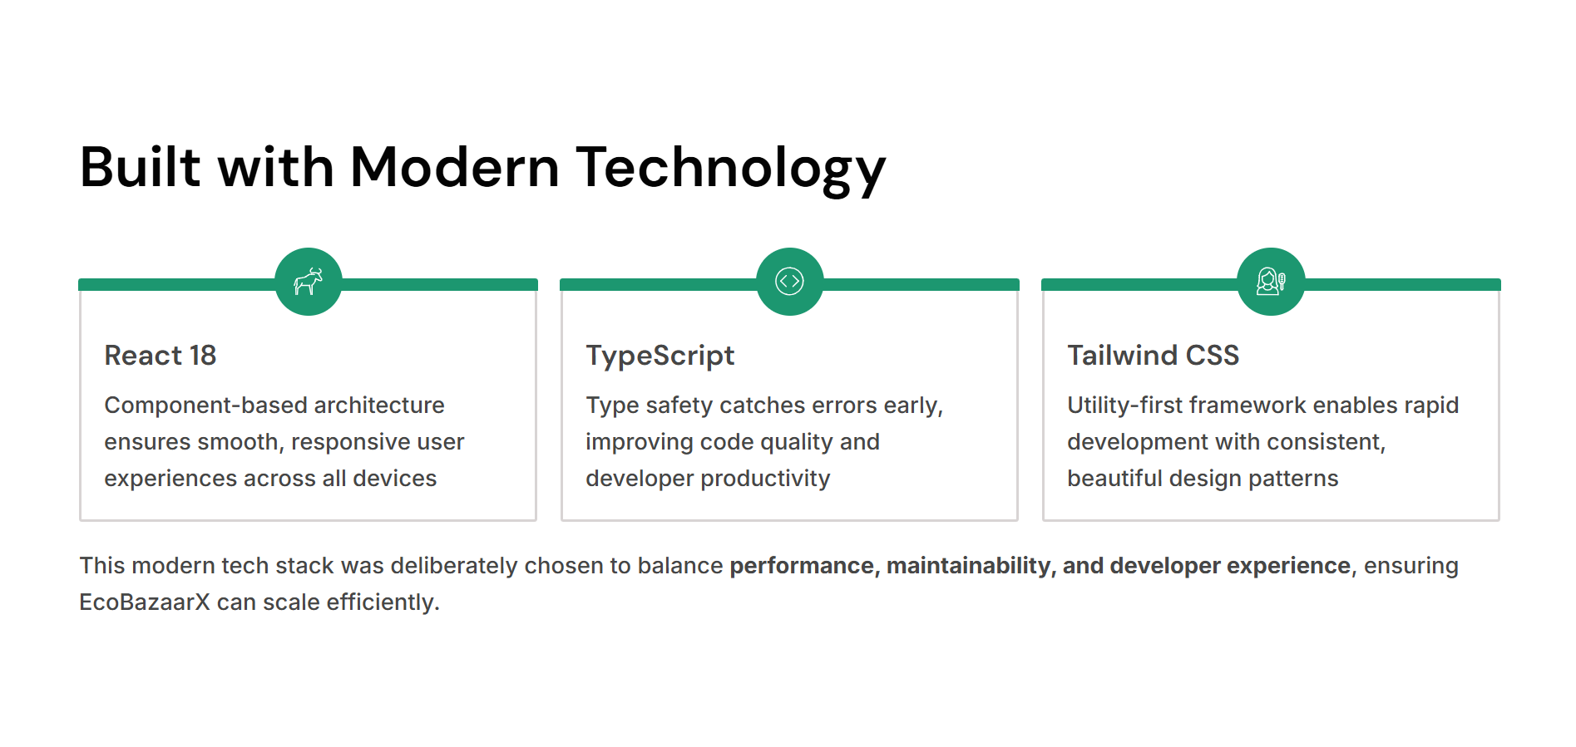

Slide 8
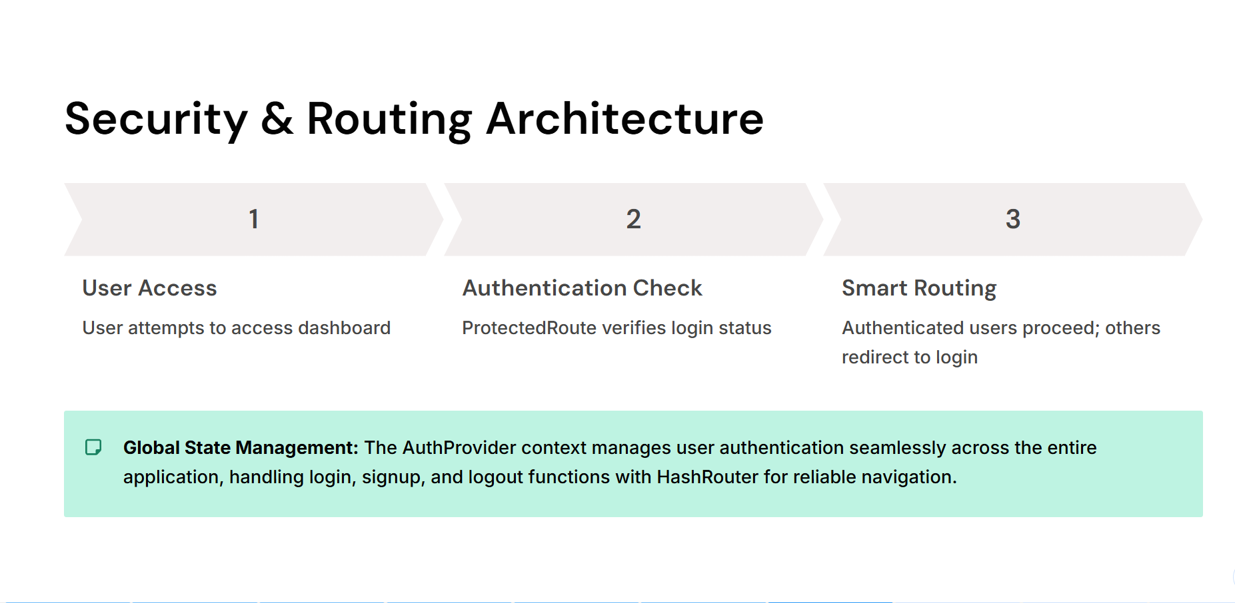

Slide 9
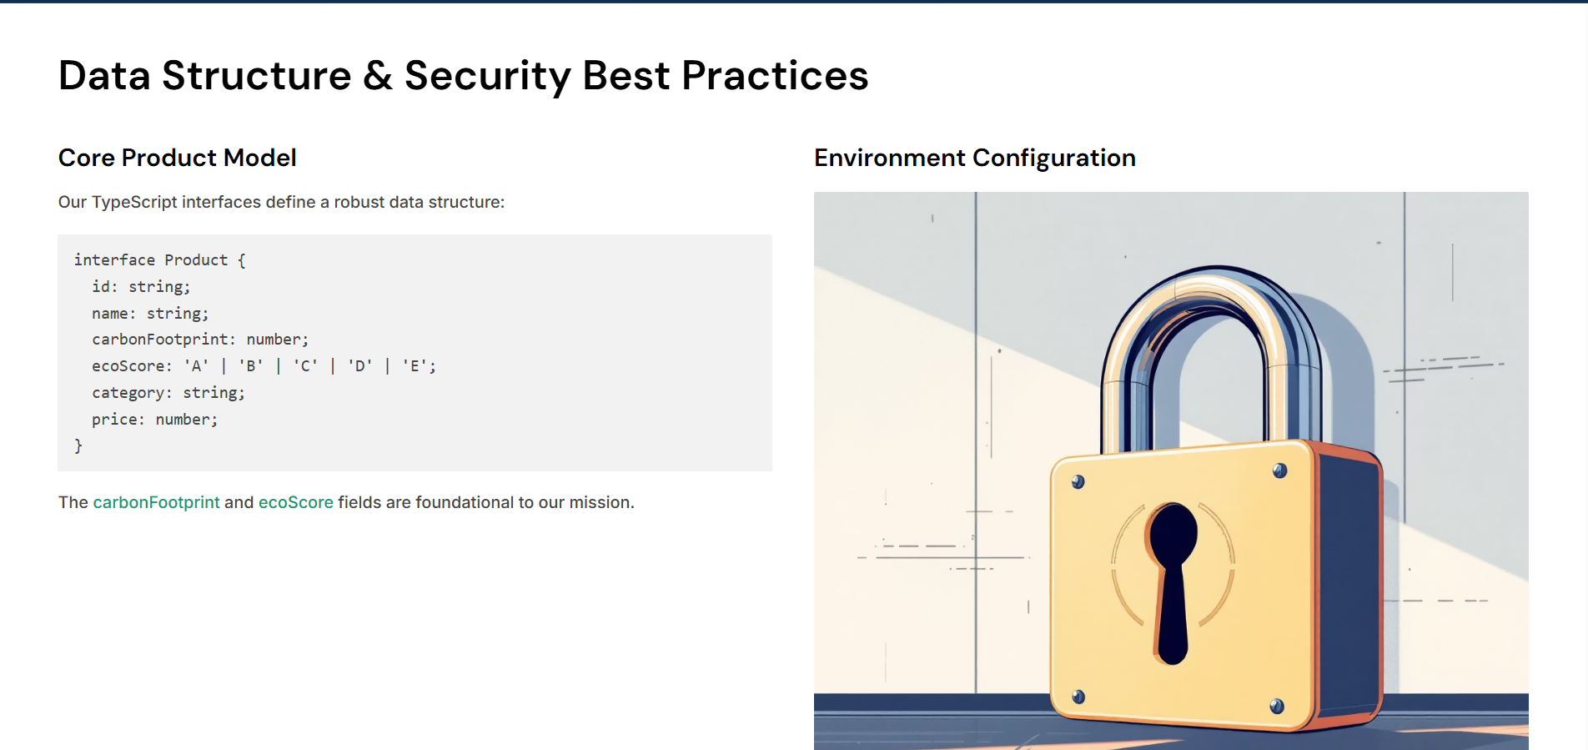

Slide 10
